Slide 1
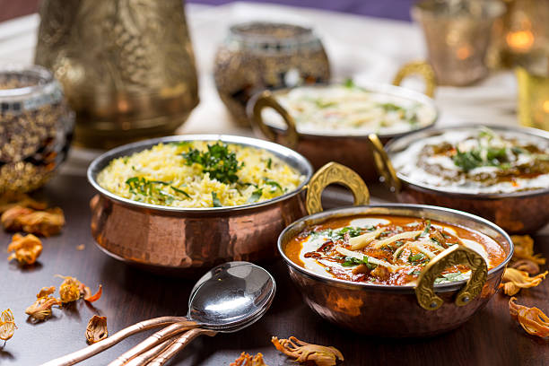
Zomato Restaurant Analysis
HARSH BHATIA
12/09/2024

Slide 2
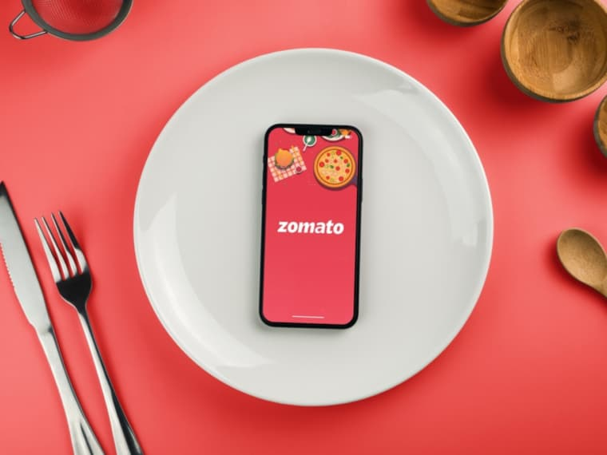
INTRODUCTION
Zomato, a leading player in the food industry, is looking to expand into new countries.
The goal is to identify potential locations for opening new restaurants based on the analysis of existing restaurant data.
The analysis must address key factors such as competition, customer ratings, and pricing to recommend the best markets.

Slide 3
DATA OVERVIEW
Key Data Points:
Total Restaurants: 9,551 restaurants across 15 countries.
Price Range: 4 categories (1: Low, 4: High)
Average Cost for Two: Range from ₹100 to ₹4,000+.
Customer Ratings: Range from 1.0 to 5.0.
Votes: Up to 10,000+ customer reviews for some restaurants.
Geographic Information: Includes country codes, cities, and localities.
Location Coordinates: Longitude and latitude data included for geographical analysis.
Cuisines: Each restaurant offers a variety of cuisines, allowing analysis of cuisine popularity across regions.

Slide 4
Data Cleaning and Preprocessing:
Handling Missing Values:
Missing values for the Average Cost for Two were filled with the country-specific average.
Missing entries for Cuisines were imputed based on locality and restaurant type.
Date Format Correction: Standardized the "Date Key Opening" to dd/mm/yyyy format.
Currency Normalization: Prices were converted to INR (Indian Rupees) for consistent comparison across countries.
Country Name Assignment: Country codes were converted to full names using the XLOOKUP function.
This data allows us to analyze critical factors like pricing, competition, customer preferences, and ratings in different regions.
The preprocessed data ensures consistency, making it possible to identify trends and recommend optimal locations for Zomato’s expansion strategy.

Slide 5
METHODOLOGY
Data Cleaning:
Missing Values: The dataset had missing values for critical fields like "Average Cost for Two" and "Cuisines." These were addressed by filling in missing costs with country-specific averages and imputing missing cuisines based on the locality and restaurant type.
Date Standardization: Date formats were inconsistent particularly for the "Date Key Opening" field. These were standardized into the "dd/mm/yyyy" format to ensure consistency in time-based analysis.
Currency Normalization: Since the data spans multiple countries, price values were listed in different currencies. So, single currency value was implemented by converting all prices to INR (Indian Rupee) to enable a uniform comparison across regions.

Slide 6
Data Enrichment:
Country Name Assignment: The original dataset contained country codes instead of full country names. Using the XLOOKUP function in Excel, country names were fetched and filled in from a separate lookup table.
Formula used: =XLOOKUP($C2,'country description'!$A$2:$A$16,'country description'!$B$2:$B$16)
Analytical Techniques
Pivot Tables: Pivot tables were extensively used to aggregate data and conduct comparisons across different countries and years. This included summarizing restaurant counts, average customer votes, and ratings by country, as well as analyzing trends like restaurants opened each year.
Trend Analysis: A time-based analysis was performed to observe the trend in restaurant openings from 2010 to 2018. This provided insights into market growth, identifying periods of rapid expansion or stagnation.

Slide 7
Total Number of Restaurants in Each Country
Insights:
India dominates with 8,652 restaurants, accounting for 90% of the total.
United States is the second-largest market with 434 restaurants.
Other notable countries: United Kingdom (80), Brazil (60), South Africa (60).
Opportunity Insight: Countries with fewer restaurants (Canada, Indonesia, Philippines) present potential for expansion.

Slide 8
Number of Restaurants opened each Year.
Insights:
Steady growth from 2010 (1,080 restaurants) to 2018 (1,102 restaurants).
Expansion Insight: Identifying years of growth can help predict favorable markets for new entries.

Slide 9
Restaurants in India Within Price Range 4.
Insights:
India has 388 restaurants within the price range of 4.
Expansion Insight: The high-end market is relatively low, providing potential for higher-priced restaurants.

Slide 10
Average Number of Votes per Restaurant by Country.
Insights:
Indonesia has the highest average votes (772 votes per restaurant), indicating high customer engagement.
Philippines (407 votes) and United Arab Emirates (493 votes) show strong engagement.
Opportunity Insight: High voter engagement in some regions indicates strong customer interest, a positive sign for potential market entry.

Slide 11
Suggested Countries for Expansion.
Insights:
Canada, Indonesia, Philippines, Australia, and South Africa are ideal markets for Zomato's expansion.
These countries show low restaurant density but relatively high customer ratings.
Lower market saturation means less competition, offering an opportunity for Zomato to establish a strong presence. Additionally, high ratings indicate positive customer sentiment, suggesting that introducing new restaurants could tap into growing demand.
Expanding into these markets allows Zomato to capitalize on regions with less competition but strong customer engagement, ensuring long-term growth potential.

Slide 12
Identifying Cities Within Suggested Countries
Insights:
Within the suggested countries, cities like Yorkton, Consort (Canada), Bandung, Bogor (Indonesia), Quezon City, Tagaytay City (Philippines), Montville, Mayfield, Paynesville (Australia), and Randburg, Inner City (South Africa) stand out.
These cities have fewer restaurants and lower average ratings compared to other urban areas.
Opening restaurants in these cities with improved services (e.g., online delivery, table booking) would fill gaps in the market, elevate competition, and improve customer experience.
Targeting cities with low competition but clear demand allows Zomato to gain a first-mover advantage, while also enhancing customer service offerings in markets that lack them.

Slide 13
Recommended Cuisines for New Restaurants
Insights:
The data suggests that certain cuisines receive higher customer ratings. Top cuisines include Continental Indian, BBQ Breakfast Southern, American Burger Grill, Burger Bar food Steak and European Contemporary.
These cuisines consistently receive ratings above 4.9, indicating strong customer preference. By offering these cuisines in new markets, Zomato can attract a wide range of customers while standing out from competitors.
Aligning with customer preferences ensures a higher likelihood of success. Offering popular cuisines can help new restaurants gain traction faster and establish a loyal customer base.

Slide 14
Should Zomato Offer Online Delivery and Table Booking?
Insights:
Restaurants offering both online delivery and table booking have higher average rating (3.48, 3.29) while those without these services average have low rating (2.81, 2.75).
Providing these services leads to higher customer satisfaction and better reviews. Since competitors in certain cities lack these options, Zomato could differentiate itself by offering these services from day one.
Improving service offerings by including delivery and booking options not only enhances customer experience but also directly impacts ratings, helping Zomato outperform local competitors.

Slide 15
Correlation Between Price Range and Ratings
Insights:
Restaurants in the higher price range (3 and 4) consistently receive better ratings compared to those in lower price ranges.
Customers associate higher prices with better quality and are more willing to provide positive feedback for premium services. Thus, positioning new restaurants in the higher price segment can enhance profitability and ratings.
Maximizing revenue potential by targeting premium segments can improve both profit margins and brand perception, helping Zomato establish itself as a top-tier brand in new markets.

Slide 16
Current Expenditure on Food in Suggested Countries
Insights:
The data shows that Philippines, Indonesia, and South Africa have the highest current food expenditures, while countries like Canada and Australia have lower but steady growth potential.
Focusing on countries with higher current expenditure ensures that Zomato enters markets where food spending is already strong, allowing for a quicker ROI.
Understanding market potential through expenditure data ensures that Zomato targets countries with a strong culture of dining out, which is crucial for sustaining and growing the business.

Slide 17
Distribution of restaurants in different Price ranges
Insights:
High-end potential: Markets like Canada, Indonesia, and the Philippines are underrepresented in the higher price categories, suggesting opportunities for Zomato to tap into the premium dining segment.
Understanding the price distribution across countries helps Zomato strategically position new restaurants. In markets where premium dining is underrepresented, there’s an opportunity for Zomato to cater to upscale customers, while in more balanced or lower-end markets, the focus should be on offering affordable yet high-quality dining experiences.

Slide 18
Strategic Recommendations
Based on the detailed analysis, here are the specific recommendations for Zomato’s expansion strategy, backed by data insights. Each recommendation targets key opportunities identified from the analysis and highlights the expected impact on business growth.
1. Expand into Under-Saturated Markets
Recommendation:
Focus on expanding into countries with lower restaurant density, such as Canada, Indonesia, Philippines, Australia, and South Africa.
Data-Driven Reason:
These countries have a relatively low number of restaurants but show strong customer ratings and engagement, indicating demand for more dining options.
Expected Impact:
Increased Market Share: By entering less saturated markets, Zomato can establish an early presence and dominate new regions.
Higher Revenue Potential: Fewer competitors mean more opportunities to attract customers and build a loyal base.

Slide 19
2. Target Cities with Low Competition and Poor Service
Recommendation:
Focus on cities like Yorkton, Consort (Canada), Bandung, Bogor (Indonesia), Quezon City, Tagaytay city (Philippines), Montville, Mayfield, Paynesville (Australia), and Randburg, Inner City (South Africa) where there are few restaurants and average ratings are low.
Data-Driven Reason:
These cities are underdeveloped in terms of quality dining options and present a gap in the market that Zomato can fill by offering superior service and better cuisine.
Expected Impact:
Increased Customer Satisfaction: Offering better services (online delivery, table booking) will differentiate Zomato from competitors, leading to improved customer experience and satisfaction.
Quick Market Penetration: Less competition allows Zomato to quickly become a preferred choice.

Slide 20
3. Focus on Premium Dining in Selected Markets
Recommendation:
Introduce more premium-priced restaurants in markets like Canada, Indonesia, and the Philippines, where high-end dining options are underrepresented.
Data-Driven Reason:
These countries have a higher concentration of restaurants in the lower price range, creating a gap in the premium dining segment (Price Range 3 and 4).
Expected Impact:
Higher Profit Margins: Catering to affluent customers in these regions will allow Zomato to command higher prices, driving profitability.

Slide 21
4. Introduce and Prioritize Online Delivery and Table Booking Services
Recommendation:
Ensure that all new restaurants offer online delivery and table booking, especially in markets where competitors lack these services.
Data-Driven Reason:
Restaurants that offer both services have a significantly higher average rating (3.6) compared to those that don’t (2.7).
Expected Impact:
Improved Customer Satisfaction: Offering convenient services will increase customer loyalty and overall satisfaction.
Competitive Advantage: Differentiating through service offerings will help Zomato attract tech-savvy customers who prioritize convenience.

Slide 22
5. Focus on High-Rated Cuisines for New Markets
Recommendation:
Serve top-rated cuisines such as Continental Indian, American BBQ, and European Contemporary in new markets.
Data-Driven Reason:
These cuisines have an average rating of 4.9, consistently outperforming others, suggesting strong customer preference.
Expected Impact:
Increased Customer Retention: By offering popular and high-rated cuisines, Zomato will attract repeat customers, fostering loyalty.
Positive Brand Image: Providing quality dining experiences through well-liked cuisines will boost Zomato’s reputation.

Slide 23
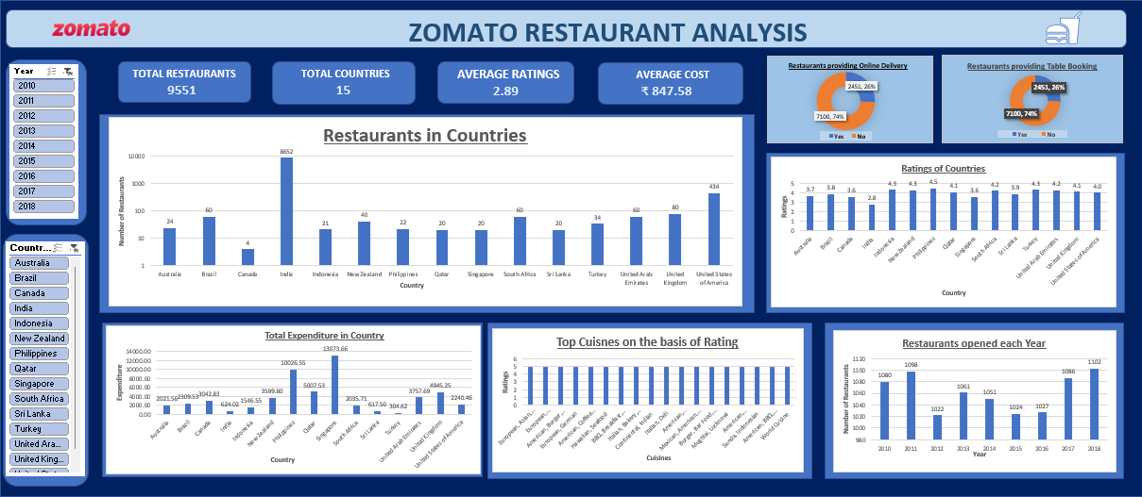

Slide 24
Dashboard and Visualization:
Top-Level Metrics:
Total Restaurants (9551): Indicates the total number of restaurants included in the analysis.
Total Countries (15): Shows the number of countries Zomato operates in, relevant for international expansion considerations.
Average Ratings (2.89): Reflects the average customer rating across restaurants, useful for assessing overall customer satisfaction.
Average Cost (₹ 847.58): The average meal cost, useful for understanding pricing strategies and affordability.
Slicers:
Year Slicer : Allows users to filter the data by a specific year to track year-on-year performance and trends.
Country Slicer : Enables users to focus the analysis on a specific country, adding interactivity for targeted decision-making.

Slide 25
Conclusion
Main Insights:
India dominates the market, but growth potential exists in smaller regions like Indonesia, Philippines, Canada, Australia and South Africa.
Online delivery and table booking services are underutilized, with only 26% adoption.
High-rated cuisines such as BBQ/Grill and Continental can drive better customer satisfaction and growth.
Recommendations:
Focus on expanding in underrepresented markets with lower competition.
Increase adoption of technology-driven services like delivery and reservations to meet customer demand.
Promote highly rated cuisines to elevate customer ratings and loyalty.
By leveraging these insights, Zomato can enhance its market presence, improve customer experience, and capitalize on growth opportunities, driving long-term success in a competitive landscape.

